Slide 1
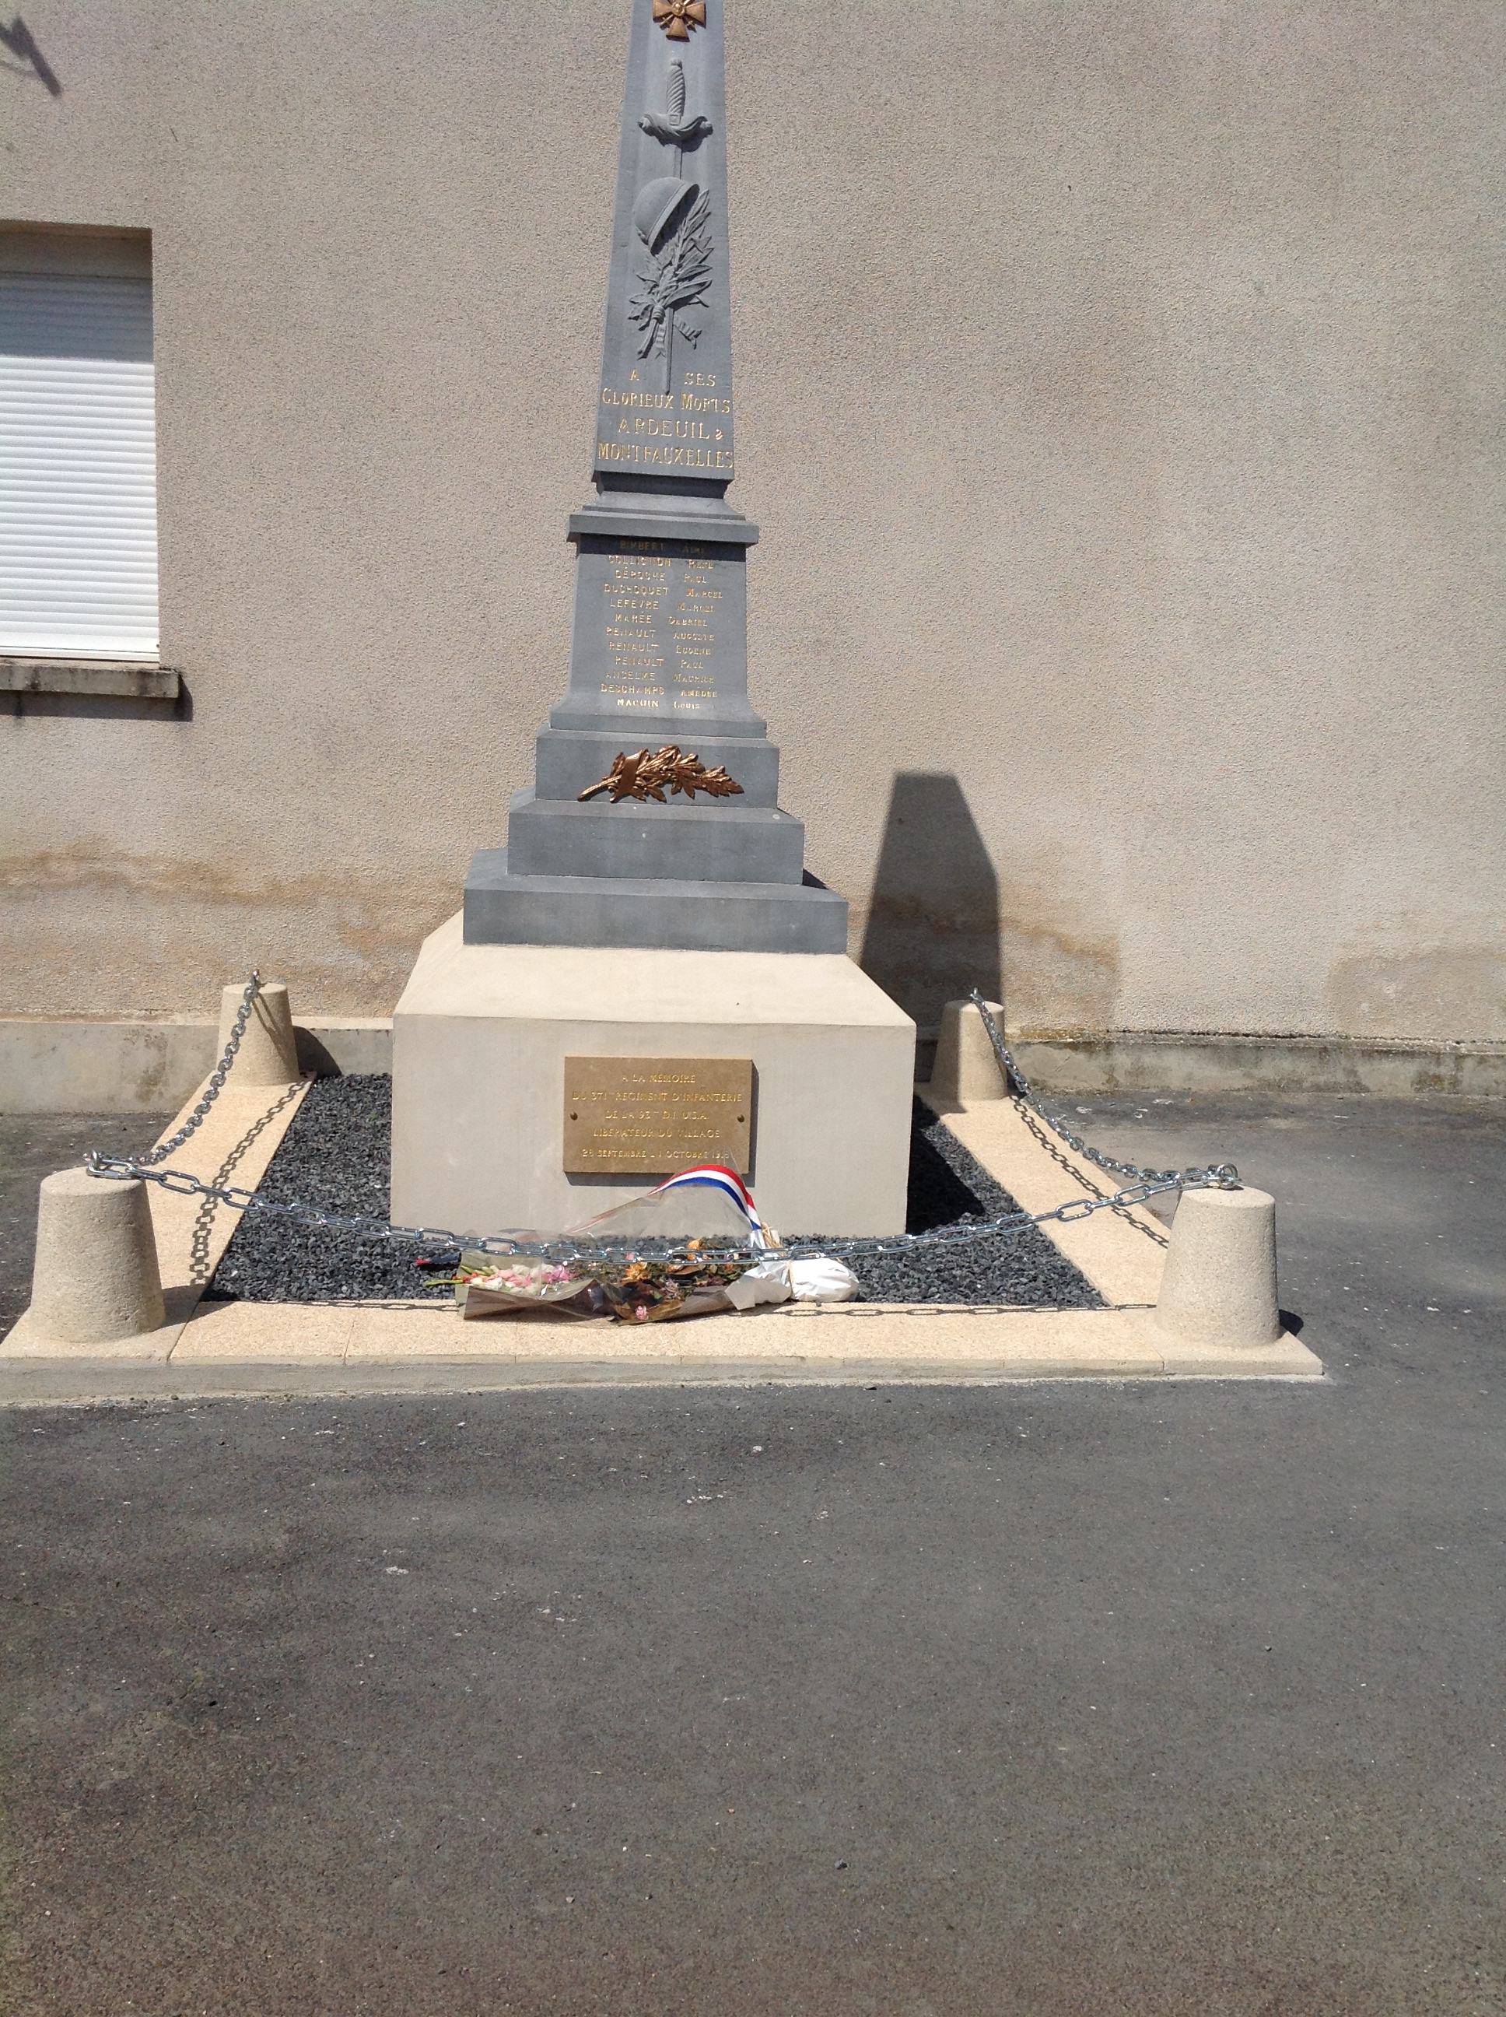
Notes:
Monument to 371st Infantry at Ardeuil-Montfauxelles

Slide 2
Notes:
Monument to 371st Infantry at Ardeuil-Montfauxelles

Slide 3
Notes:
Monument to 371st Infantry at Bussy Farm

Slide 4
Notes:
Monument to 371st Infantry at Bussy Farm

Slide 5
Notes:
Monument to 371st Infantry at Bussy Farm

Slide 6
Notes:
Monument to 371st Infantry at Bussy Farm

Slide 7
Notes:
Monument to 371st Infantry at Bussy Farm

Slide 8
Notes:
Monument to 371st Infantry at Bussy Farm

Slide 9
Notes:
Monument to 371st Infantry at Bussy Farm

Slide 10
Notes:
Monument to 371st Infantry at Bussy Farm

Slide 11
Notes:
Monument to 371st Infantry at Bussy Farm

Slide 12
Notes:
Monument to 371st Infantry at Bussy Farm

Slide 13
Notes:
Monument to 371st Infantry at Bussy Farm

Slide 14
Notes:
Monument to 369th Infantry at Sechault

Slide 15
Notes:
Monument to 369th Infantry at Sechault

Slide 16
Notes:
Monument to 369th Infantry at Sechault

Slide 17
Notes:
Monument to the 372nd Infantry at Monthois

Slide 18
Notes:
Monument to the 372nd Infantry at Monthois

