Slide 1
Section 5, Gallery 2
Training in the United States

Slide 2
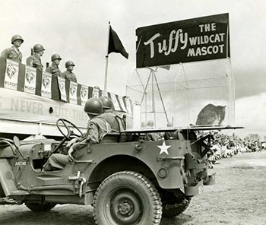
Tuffy the Mascot

Slide 3
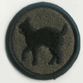
Wildcat Shoulder Patch

Slide 4
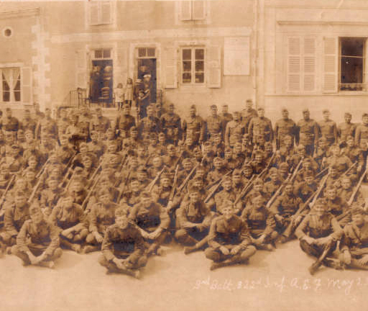
Will McGuirt and the 81st Division

Slide 5
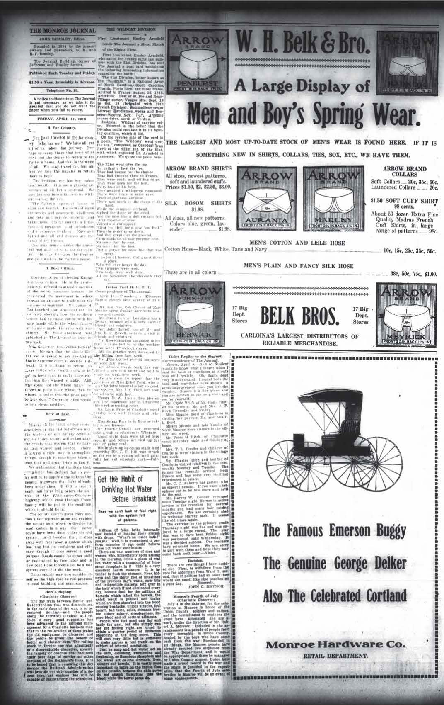
The Monroe Journal, Friday, April 11, 1919 - Wildcat History

Slide 6
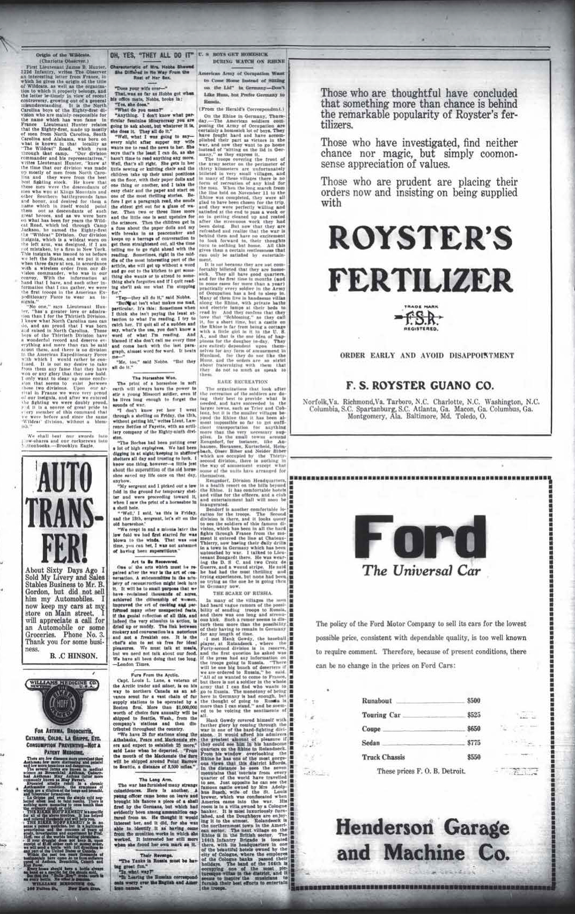
The Monroe Journal, Friday, February 7, 1919 - Wildcat History

