Slide 1
ABMC Images and SCIM-C
Using visuals and close reading to build chronology

Slide 2
SCIM-C
Summarizing
Contextualizing
Inferring
Monitoring
Corroborating
Notes:
See pull out in chapter on details of SCIM-C

Slide 3
SCIM-C Model
Breaking down SCIM-C

Slide 4
SCIM-C Questions
Go through these questions with students to help them gain a better understanding of how to use SCIM-C and what they should be looking for when filling out information.

Slide 5
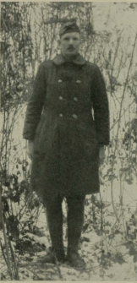
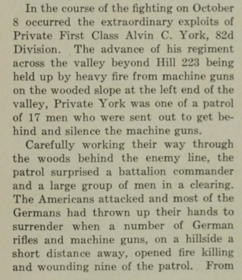
Sergeant Alvin C. York
Notes:
This image, along with the texts provided, can be found on pages 229-230 in the ABMC Blue Book. Use the information here to provide students with information on the actions of one soldier during the Meuse-Argonne offensive and have them complete the SCIM-C chart as they read. Where does his story fall in the chronology of this battle? What does it tell us about the whole of World War One? What is missing that they would like to know? Where can they go to find those answers?

Slide 6
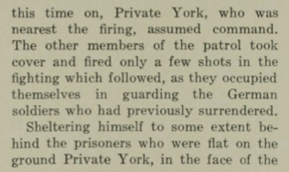
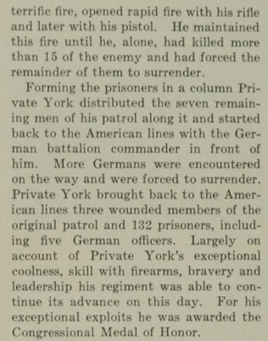
Private Alvin C. York Continued

Slide 7
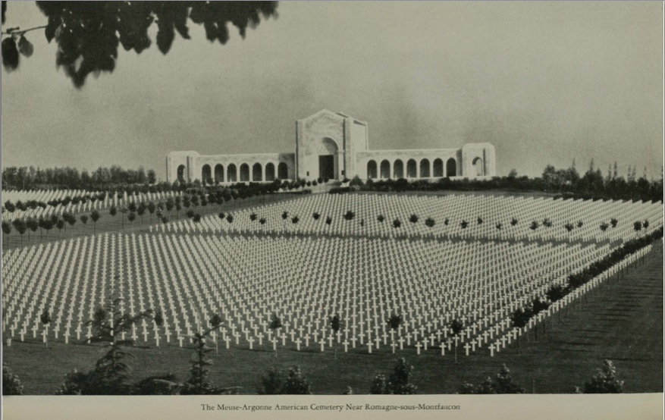
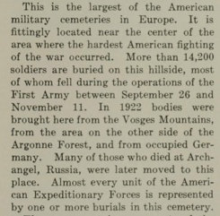
The Meuse-Argonne American Cemetery Near Romagne-sous-Montfaccon
Notes:
This image, along with the text provided, can be found on pages 246 and 247 of the ABMC Blue Book. This short paragraph provides basic information on the significance of this cemetery. Once students fill out their SCIM-C chart based on the limited information provided here, ask them to find page 247 in their Blue Book for additional information they can use to fill out their chart and gain a better understanding of this cemetery, the brave people buried here, and its context within the battle and World War One.

Slide 8
SCIM-C Chart Options

