Slide 1
Why is World War I considered the first modern war?

Slide 2
Define“modern.”

Slide 3
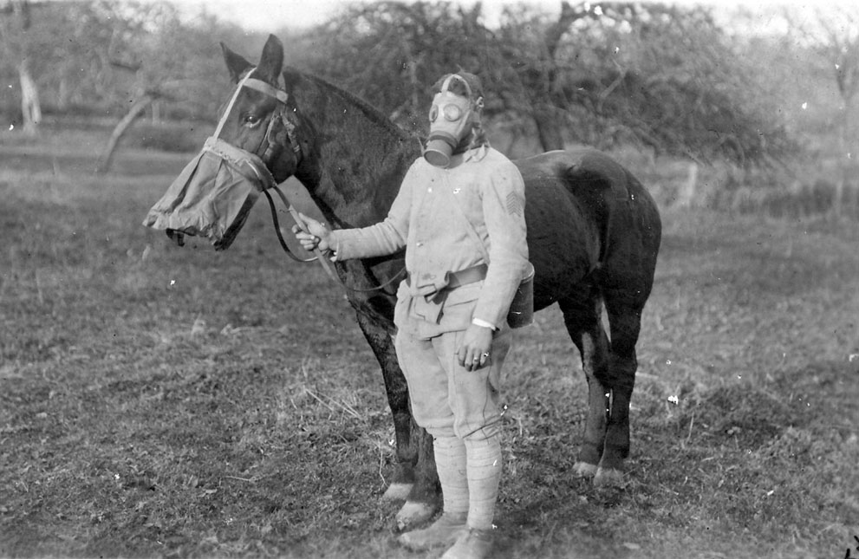
What is modern in this photo?
What is not modern is this photo?

Slide 4
List of elements in modern war (weapons, strategies, etc.):

Slide 5
List of partner group interpretations:

Slide 6
List of partner group interpretations:

Slide 7
EXIT TICKET: Why is World War I considered the first modern war?

